Slide 1


Slide 2
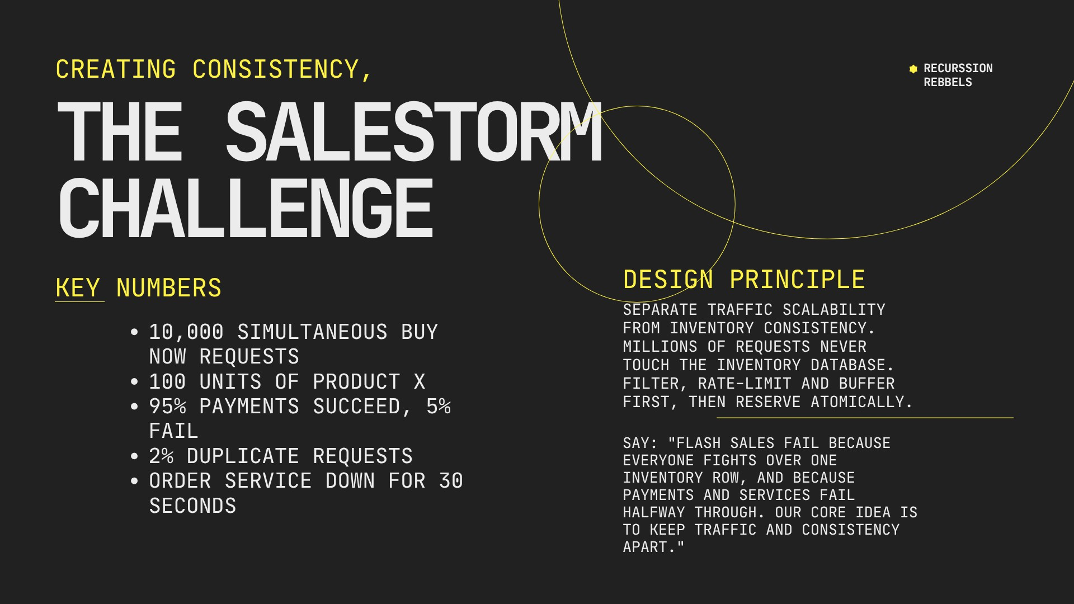

Slide 3
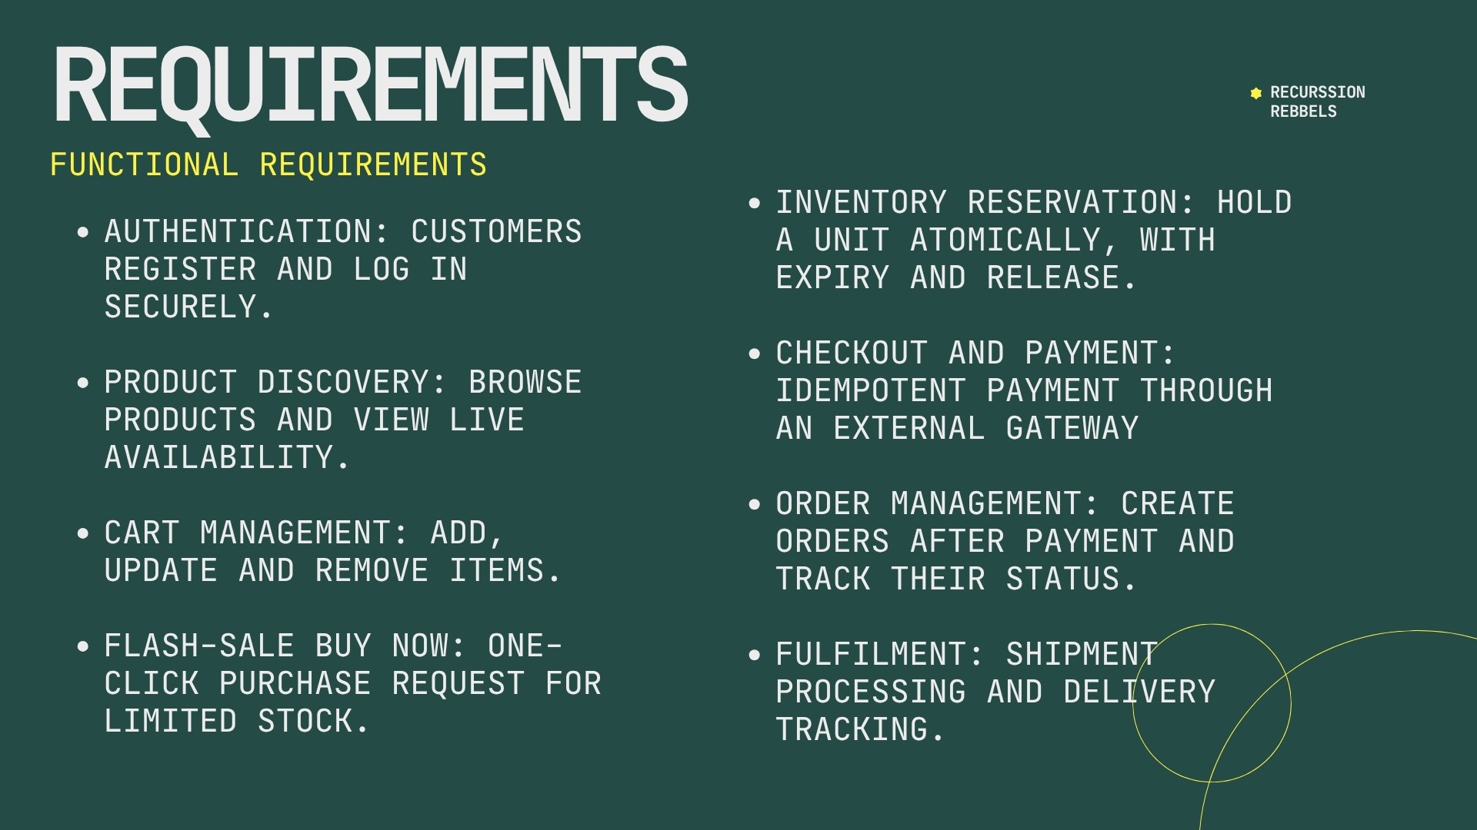

Slide 4
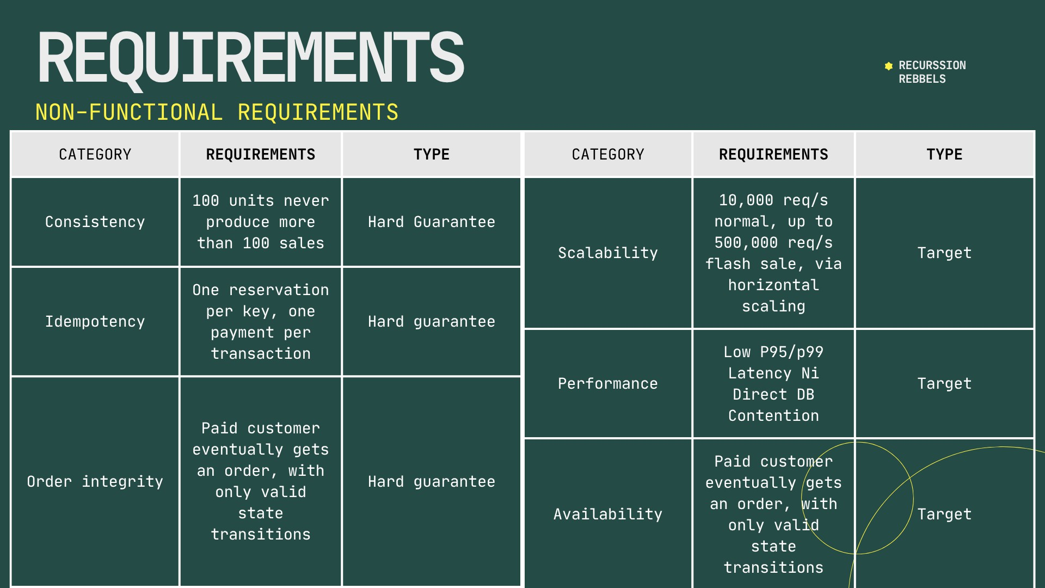

Slide 5
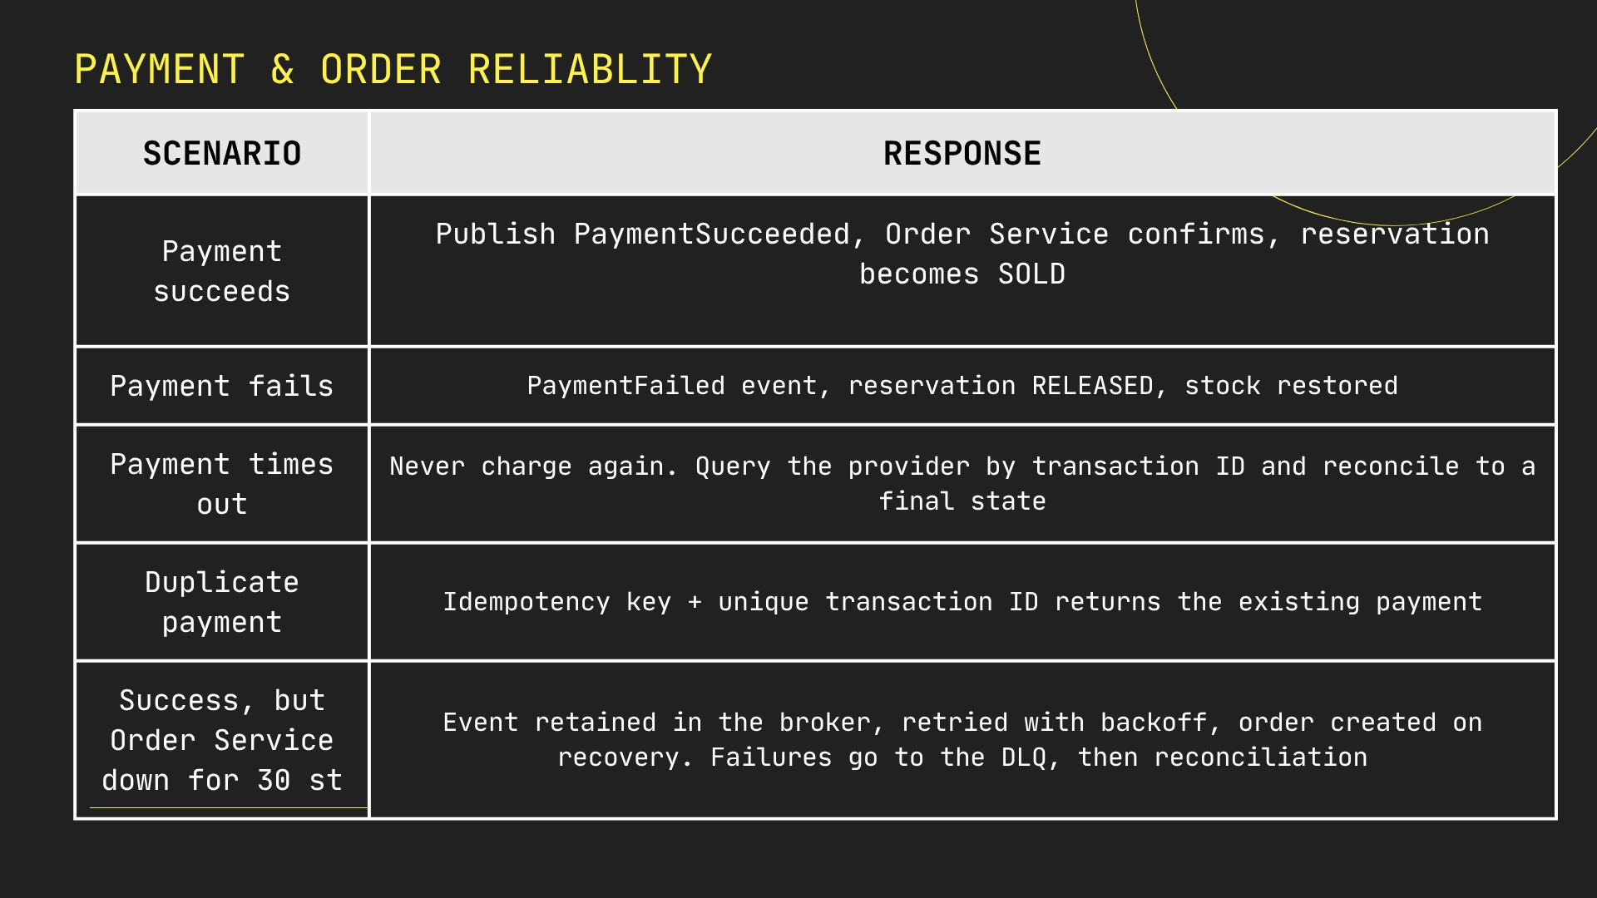

Slide 6
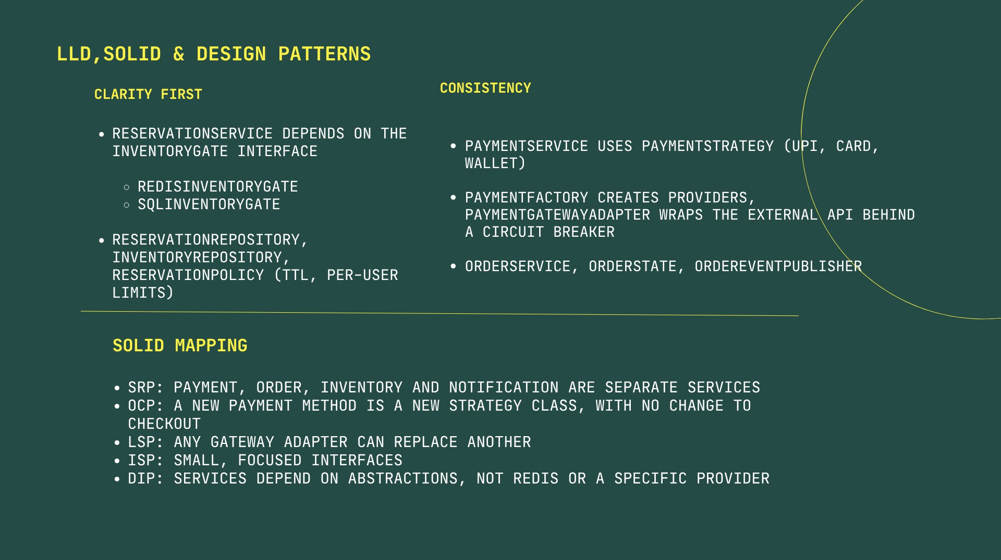

Slide 7
ARCHITECTURE
HIGH-LEVEL ARCHITECTURE
RECURSSION REBBELS
CDN + WAF
LOAD BALANCER
API GATEWAY
Auth + Rate Limit
SALE SERVICE
Idempotency check
RESERVATION QUEUE
→
→
→
→
INVENTORY WORKER
REDIS ATOMIC GATE
fast reservation
SQL DATABASE
source of truth
CHECKOUT →
PAYMENT SERVICE
EXTERNAL PAYMENT GATEWAY
MESSAGE BROKER
+ DLQ
ORDER SERVICE
SHIPMENT SERVICE
NOTIFICATION
Redis + SQL linked by reconciliation. Sync: browse, reserve status, checkout. Async: payment events, orders, shipment, notifications.

Slide 8
CORE OF THE SOLUTION
RECURSSION REBBELS
REDIS + SQL GATE
10,000 REQUESTS
↓ queue absorbs burst ATOMIC LUA SCRIPT
↓
100 RESERVED
9,900 → OUT_OF_STOCK
RESERVATION LIFECYCLE
AVAILABLE → RESERVED → PAYMENT_PENDING → CONFIRMED → SOLD
RESERVED → PAYMENT_FAILED / TIMEOUT → RELEASED
PAYMENT_PENDING → PAYMENT_TIMEOUT → RECONCILIATION
WHY BOTH?
IF stock > 0
DECR stock
CREATE reservation (TTL) ELSE
REJECT OUT_OF_STOCK
Redis: fast gate, takes the burst
SQL: durable truth, UNIQUE(idempotency_key)
Expiry worker releases expired expires_at
Mismatch: pause gate, rebuild Redis from SQL, audit, alert

Slide 9
SCALE + WALKTHROUGH
RECURSSION REBBELS
10,000 CLICKS
1 EDGE
CDN/WAF filter bots, LB spreads load, gateway rate-
limits
THE OTHER 9,900
Fast OUT_OF_STOCK, no DB hit.
Failed payments free units for waiting users.
2 DEDUPE
Idempotency-Key returns the same reservation for repeats
3 RESERVE
Queue feeds workers, Redis gate allows only 100
50x TRAFFIC
Stateless services scale out, more queue consumers, partitioned broker, read replicas. Bottleneck (inventory gate)
stays isolated.
4 PAY
Pay with idempotency, PaymentSucceeded event, Order confirms
5 RECOVER
Failed or expired reservations are released, reconciliation checks stock
Guarantee: 100 units never become more than 100 sales.

Slide 10


